Slide 1
ELEMENTARY STATISTICS, BLUMAN
Empirical Rule - Introduction
© 2019 McGraw-Hill Education. All rights reserved. Authorized only for instructor use in the classroom. No reproduction or further distribution permitted without the prior written consent of McGraw-Hill Education.

Slide 2
Objectives for this PowerPoint
What the empirical rule says about the distribution of bell-shaped data for specific intervals in the data set.

Slide 3
Empirical Rule
When a distribution is bell-shaped the following statements are true:
Approximately 68% of the data values will fall within 1 standard deviation of the mean.
Approximately 95% of the data values will fall within 2 standard deviations of the mean.
Approximately 99.7% of the data values will fall within 3 standard deviations of the mean.

Slide 4
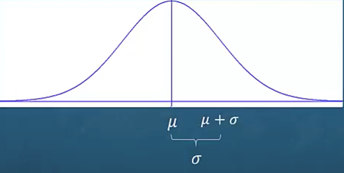
Explanation of Rule (1)
Let’s begin with the first statement.
One of the characteristics of a bell-shaped distribution is that the distribution is symmetric on either side of the mean. If we add 1 standard deviation to the mean we can establish an interval endpoint to the right of the mean.

Slide 5
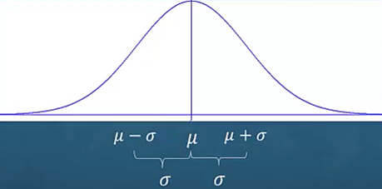
Explanation of Rule (2)
If we then subtract 1 standard deviation from the mean we wind up with a left endpoint for the interval.

Slide 6
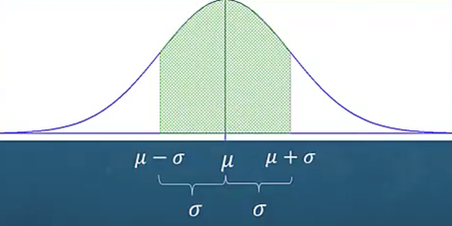
Explanation of Rule (3)
Everything that falls inside of this interval would be within 1 standard deviation of the mean.

Slide 7
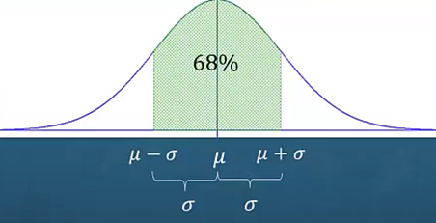
Explanation of Rule (4)
The empirical rule tells us that this would represent 68% of the entire data set.

Slide 8
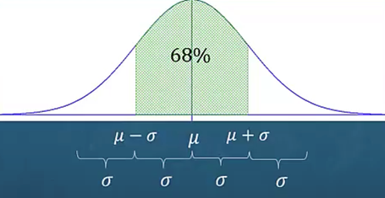
Explanation of Rule (5)
Now let’s add 1 more standard deviation to the right-hand interval endpoint and subtract 1 more standard deviation from the left-hand interval endpoint.

Slide 9
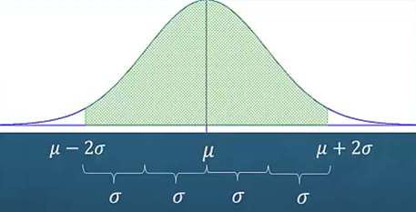
Explanation of Rule (6)
This would result in an interval that would contain all of the data values that are within two standard deviations of the mean.

Slide 10
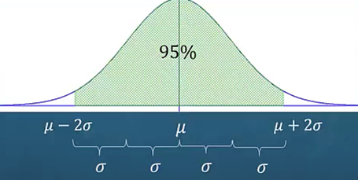
Explanation of Rule (7)
The empirical rule tells us that approximately 95% of the entire data set would fall within this interval.

Slide 11
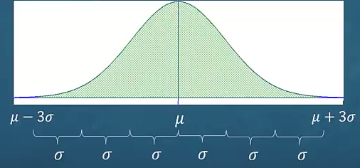
Explanation of Rule (8)
Extending 1 more standard deviation on each end of the interval would create a new interval where all of the data values are within 3 standard deviations of the mean.

Slide 12
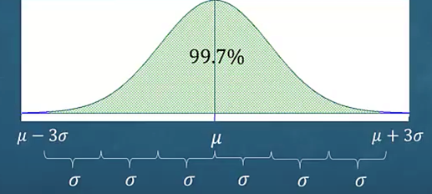
Explanation of Rule (9)
The empirical rule tells us that approximately 99.7% of the entire data set would fall between these interval endpoints.

Slide 13
Summary
In this PowerPoint we learned what the empirical rule says about the distribution of bell-shaped data for specific intervals in the data set.

